Slide 1

Leaders in Environment Analysis and Definition of Strategy

Slide 2
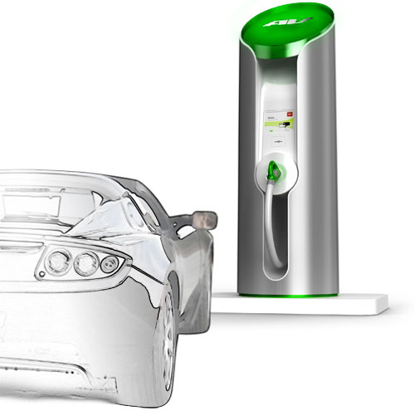
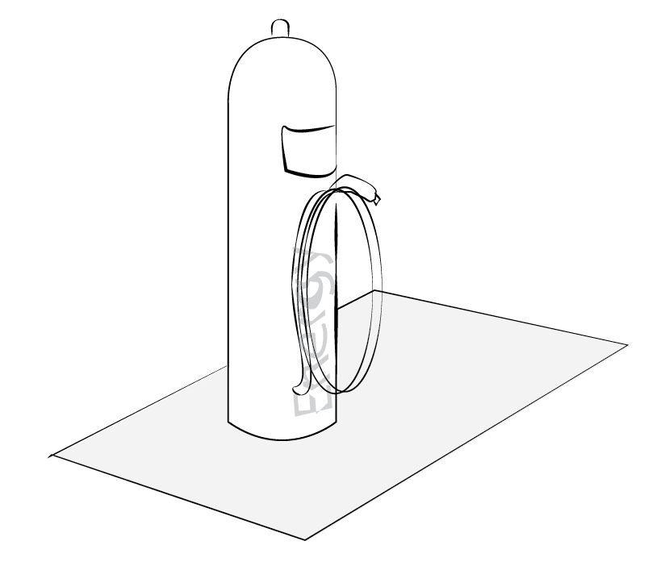
Source: http://www..clubcandoca.com.br

Slide 3
Electrical Car Charging
Connecting
The Grid
Accessibility
Environment
Energy distribution
Data Technology

Slide 4
[Our Logic Model]

Slide 5
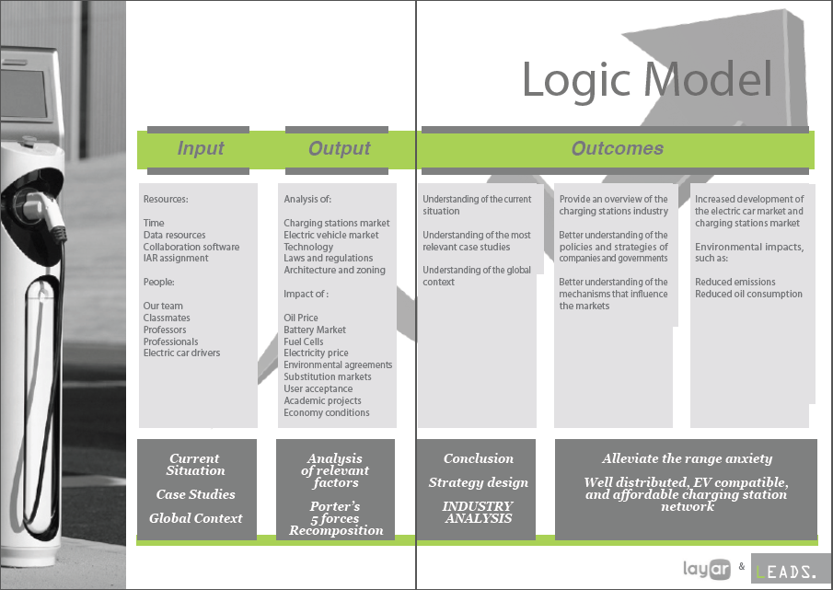

Slide 6
[Layar]

Slide 7



Slide 8
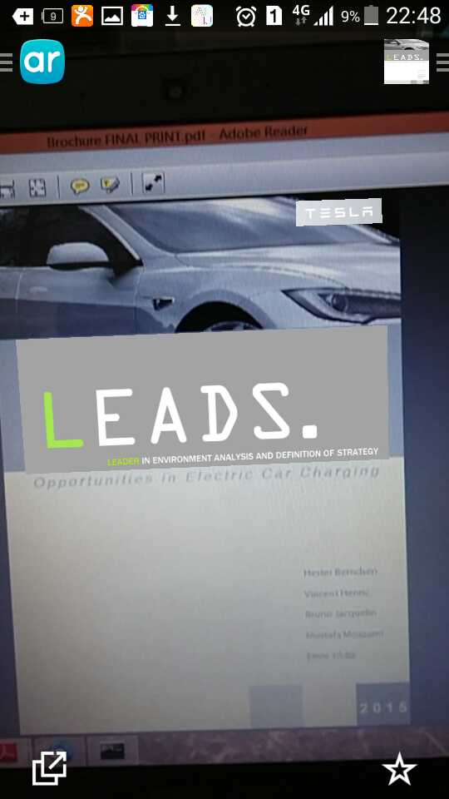

Slide 9
Leaders in Environment Analysis and Definition of Strategy

